Slide 1
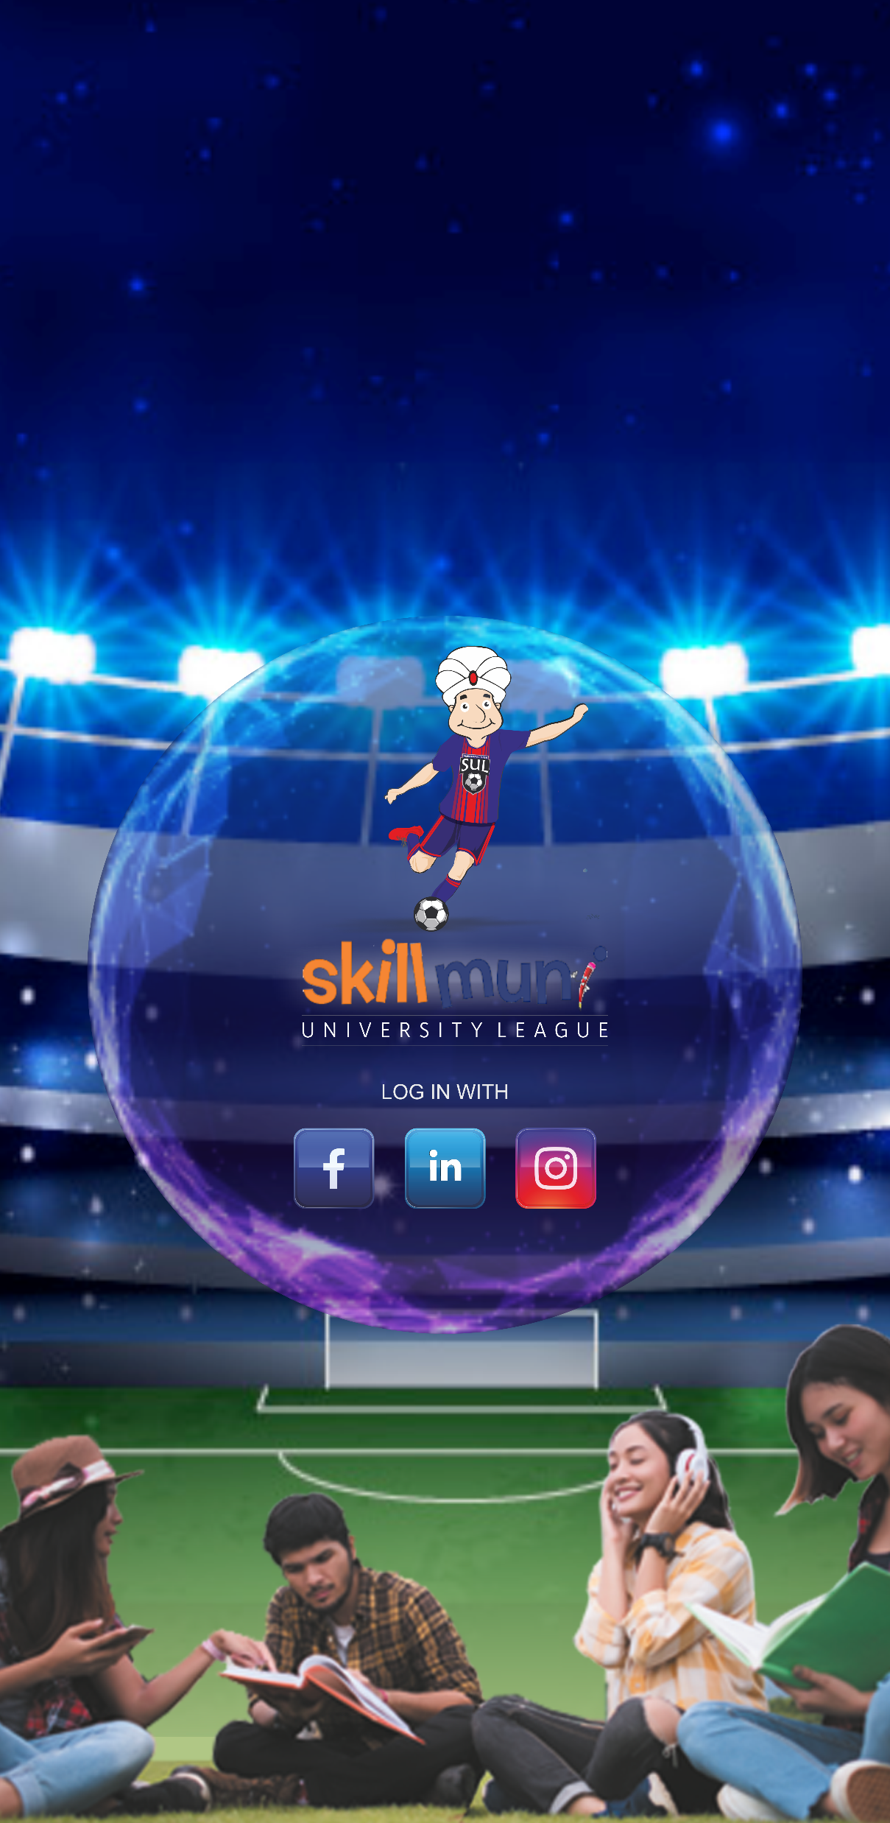


Welcome to Skillmuni University League

Slide 2
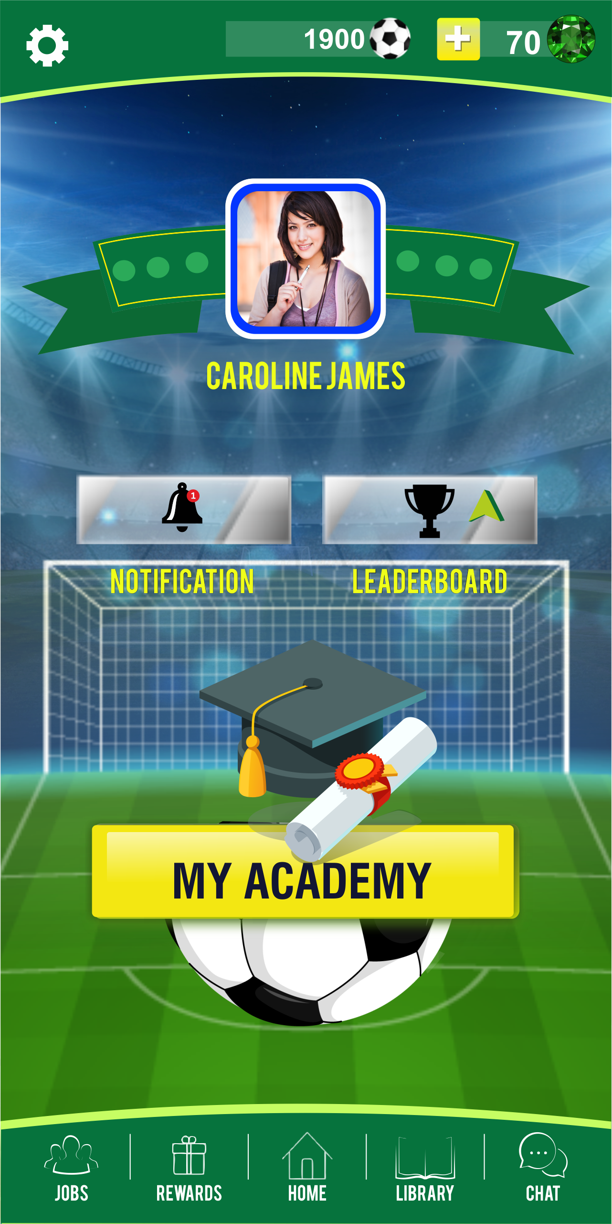

Tap on your photo to see the dashboard
Tap on My Academy and start playing.

Slide 3
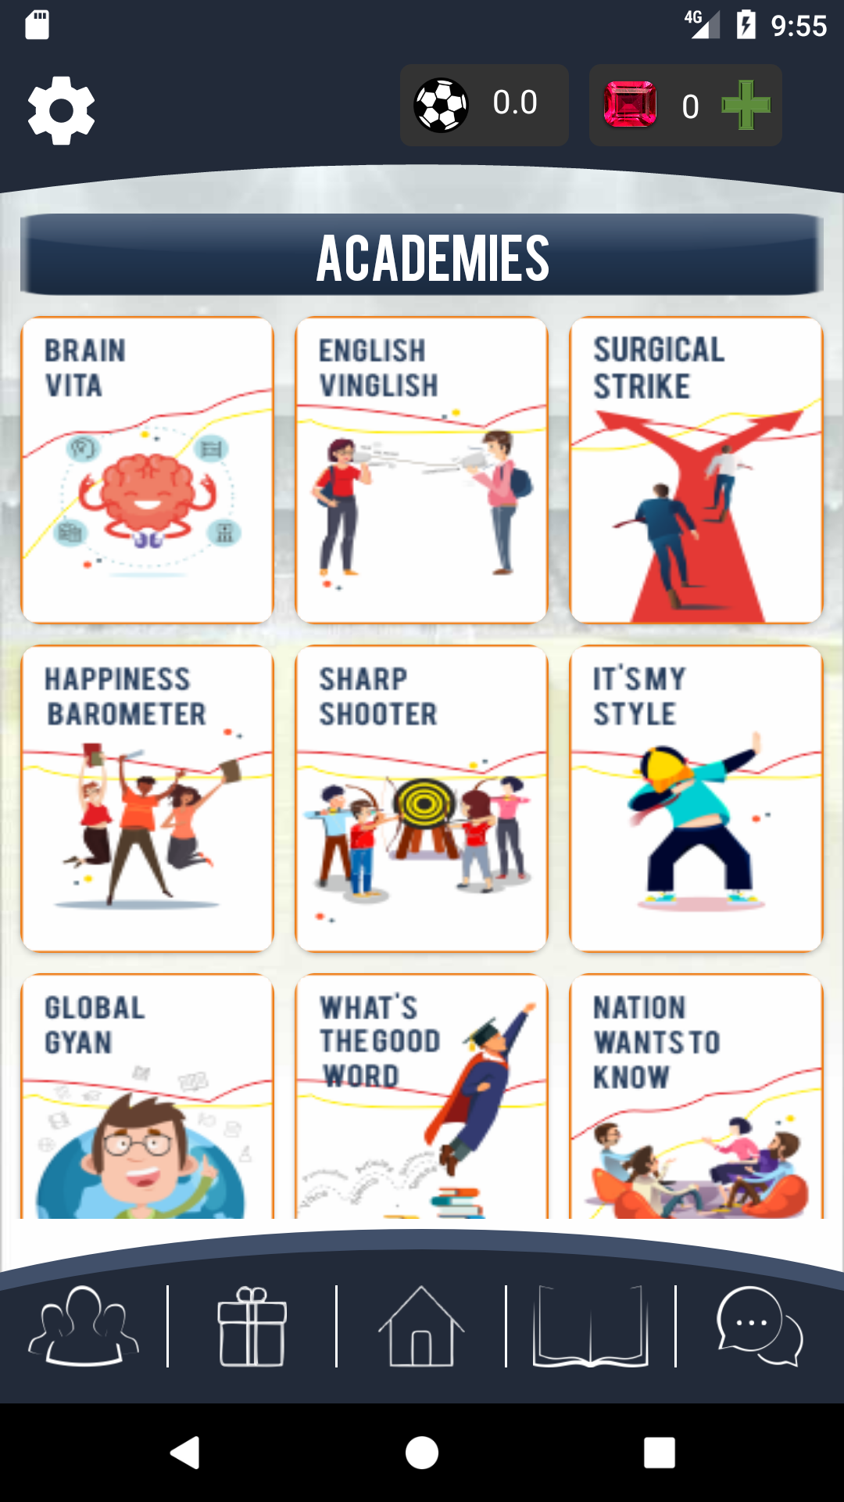
Explore the Academies by tapping on them

Slide 4
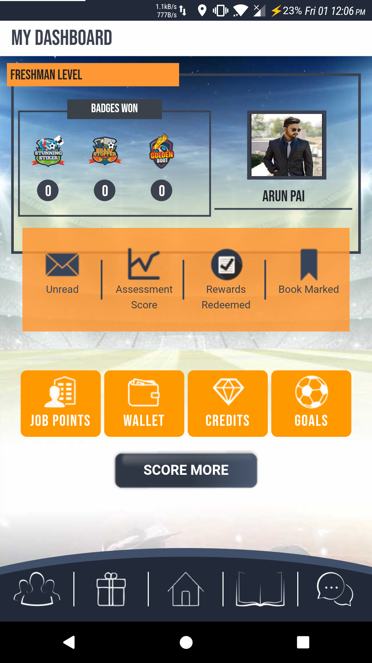
This is your dashboard

Slide 5
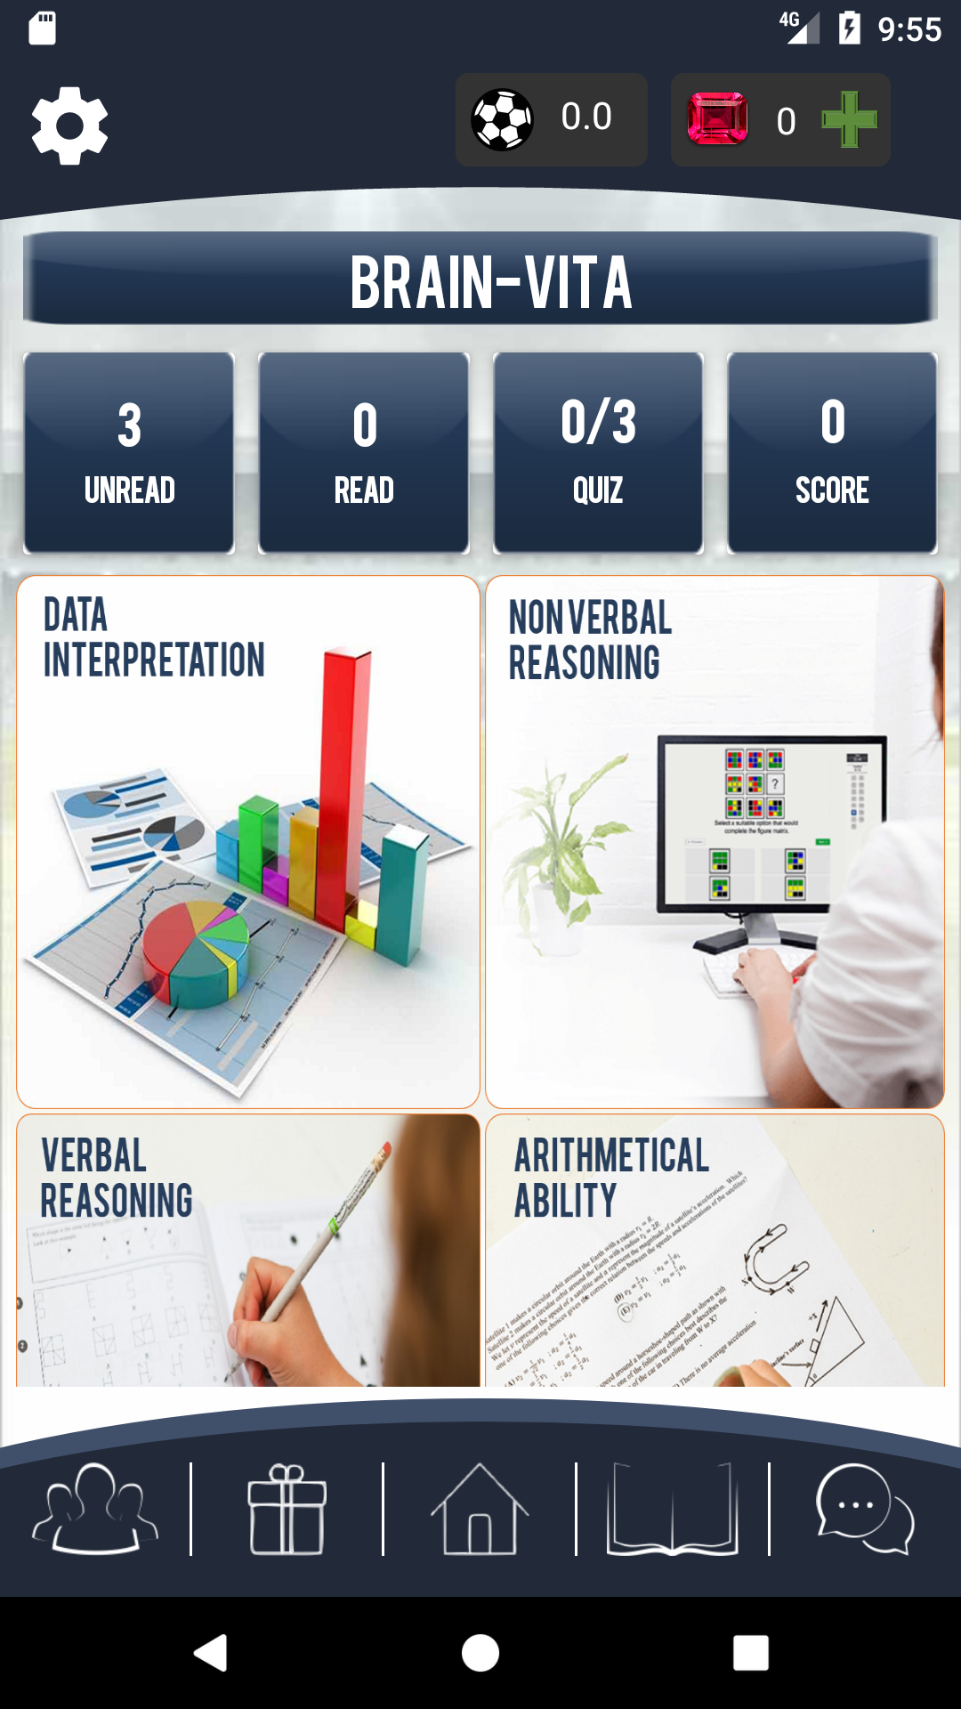
Explore the subtopics associated with academies

Slide 6
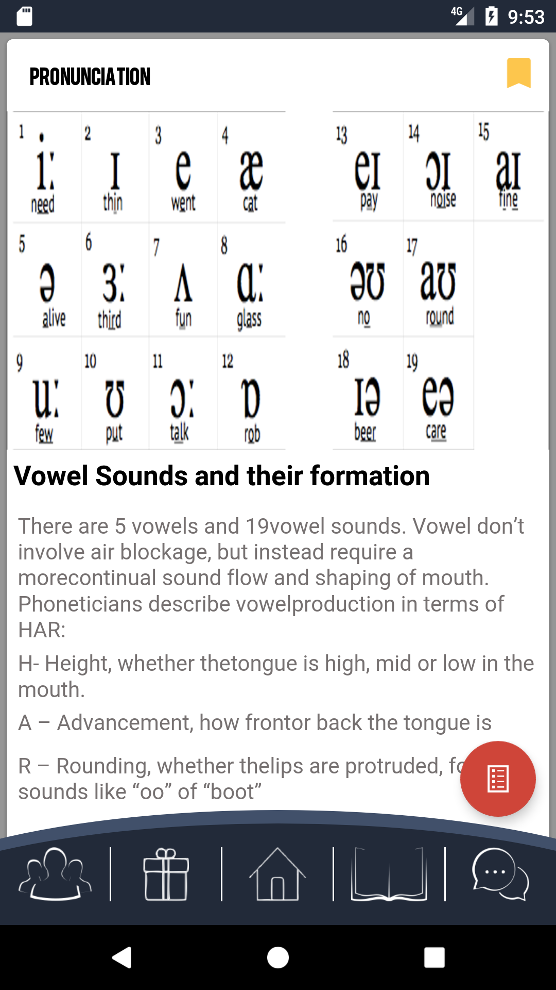
Read the brief and get yourself assessed.

Slide 7
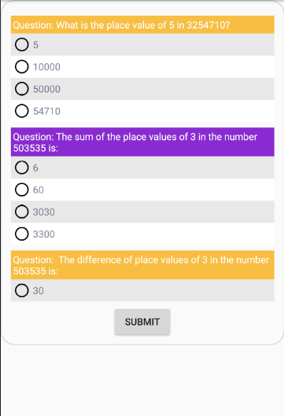
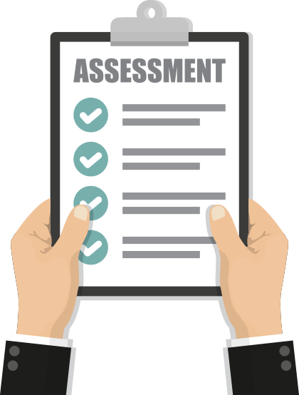
Complete the assessment

Slide 8
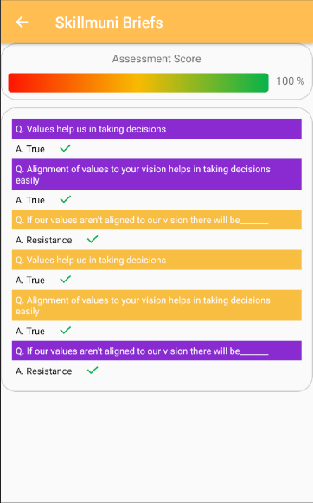

Get your result.

Slide 9
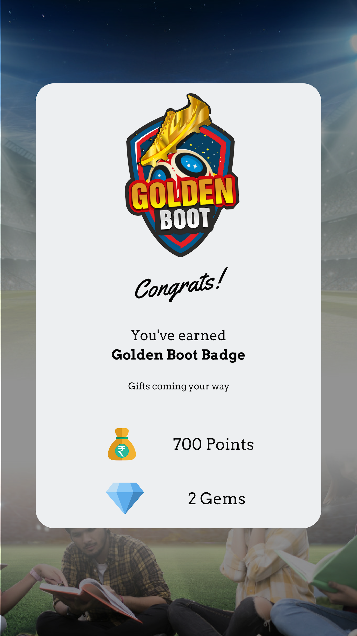
Get your Badge And Unlock Your Rewards

Slide 10
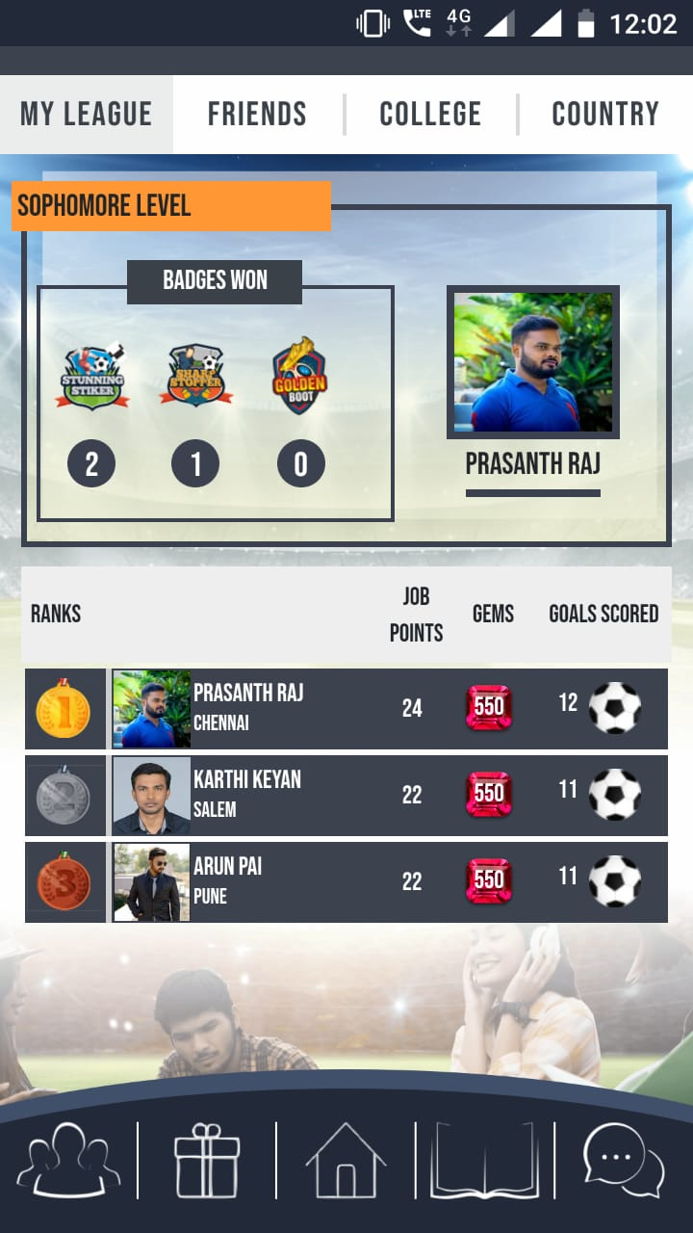
This is where you stand on the Leaderboard

